Slide 1
Survey: Aerial Base Station Placement in Future Cellular Networks
Tuna Temiz
Supervisor: M.Sc. Oleksandr Andryeyev

Slide 2
Contents
Introduction
Classification of Works
  Energy Optimization Problem
  Optimal Placement Problem
  Trajectory Optimization Problem
Open Research Issues And Challenges
Conclusion and Lessons Learned

Slide 3
Introduction
Aerial Base Station: flying antenna system that works as a hub between the backhaul network and the access network.
To provide "connectivity from the sky” is one of the innovative aspects of the 5G network
Advantages against classical network architectures:
  ability to deploy on-demand networks at specific locations
  mobility, flexibility in three-dimensional space, adaptive altitude, and symmetric rotation etc.

Slide 4
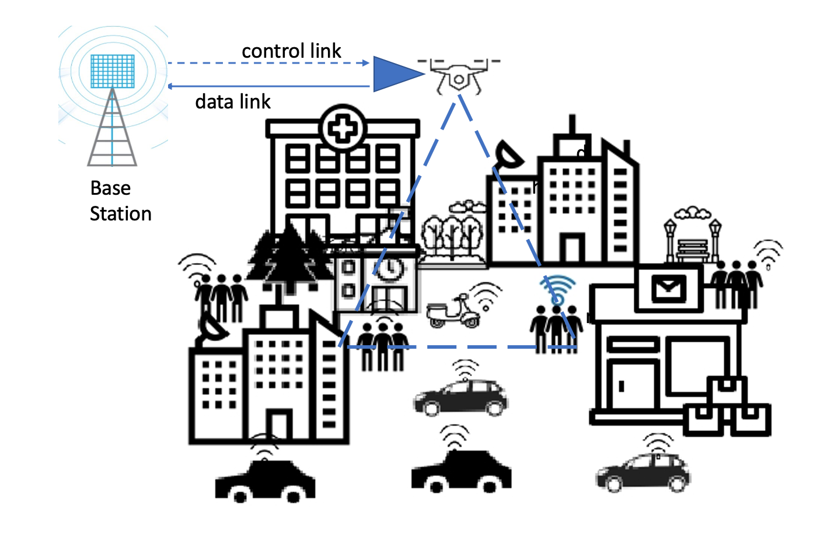
Figure: Network scenario with ABS deployment [1]

Slide 5
Introduction (cont.)
Many different use cases including:
  Temporary events (concerts, sports events etc.)
  Emergency situations
  Search and rescue operations
  Usage in zones or rural areas without pre-existing solid network infrastructure
High altitude and low altitude versions, designed for all these different purposes.
Rather new approach, therefore a hot topic of research with a wide plethora of issues.
  Surveys in the domain therefore beneficial for informing oneself in current and future work.

Slide 6
Classification of Works
Classification based on problem domain
Broad classification of issues:
  Energy Optimization Problem
    Works where the vehicle is in active operation
    Works where the vehicle is not in active operation
  Optimal Placement Problem
    Past works
    Most recent works
  Trajectory Optimization Problem
    Works involving a single unmanned aerial base station
    Works involving multiple unmanned aerial base stations

Slide 7
Energy Optimization Problem
ABSs, and UAVs in general, are really energy limited systems.
This aspect poses critical bounds on their hovering and flight time, and some trade off can arise in terms of quality of services provided to user.
Approaches include active operation energy optimization measures and the implementation of sleep/standby modes

Slide 8
Energy Optimization Problem (cont.)
In active operation: Methods like programming of linear integers to optimize energy propulsion, simplifying the scheduling process, employing IoT devices on the ground or directly working on the battery itself.
Not in active operation: Heavy focus on Markov decision processes for producing sleep cycles, in general the employment of a “2-state-model”, newer variations exist with more states.

Slide 9
Optimal Placement Problem
The problem of finding an optimum location and/or path planning is more challenging for ABSs compared to the conventional terrestrial BSs.
While freedom of movement is available, must consider issues such as:
  maintain LoS connectivity
  energy limitations
  obstacles collision avoidance

Slide 10
Optimal Placement Problem (cont.)
Challenges are hard to predict, solutions are, in general, application based.
Example problem: ABS supported cellular coverage
  Solution: deploy static ABS that hovers above the center of the area to be covered

Slide 11
Optimal Placement Problem (cont.)
What about real time applications and moving devices?
  more intuitive to employ more than one ABSs to cooperatively achieve low delay and high reliability communications
Works focus on algorithms with different approaches, such as minimizing delay or the number of required vehicles. Methods include employing entropy nets or particle swarm optimization.

Slide 12
Optimal Placement Problem (cont.)
Work increases exponentially through time.
Recent approaches include deep reinforcement learning, benchmarked against past existing placement algorithms.
Computational complexity remains a limitation, in addition to energy constraints.

Slide 13
Trajectory Optimization Problem
Trajectories must consider many factors:
  the duration of the flight
  preventing collisions
  the needs of all the users on the ground
  limitations caused by energy
Solutions that consider only a single ABS are naturally simpler.

Slide 14
Trajectory Optimization Problem (cont.)
Single vehicle approaches include employing antennas and photogrammetric projection for energy aware solutions.
Multiple vehicle approaches have the risk of collision, methods such as mixed integer programming are employed, many of which are suboptimal.
Constant communication between vehicles is a must, however newer approaches are available to ease the constraints.

Slide 15
Open Research Issues and Challenges
Placement issue made difficult due to different altitudes of operation.
Increasing the number of vehicles is a solution but causes more complexity as well as higher costs.
Works in both 3D and 2D (fixed altitude) space underway.

Slide 16
Open Research Issues and Challenges (cont.)
Great mobility brings great flexibility, but hardware limitations are significant.
Some approaches allow active operation during movement, others do not.
Combination of placement and mobility necessary for efficient use.

Slide 17
Open Research Issues and Challenges (cont.)
Operation time of ABSs are very short, causing severe limitations.
Energy consumption is generally classified into two: electronic and mechanic.
Replacing ABSs low on energy is a new and costly approach.
Following the battery power of the vehicle in real time remains an issue as well.

Slide 18
Open Research Issues and Challenges (cont.)
Significant potential for future 6G+ networks despite limitations, many works underway.
A new approach includes using tethers to charge the vehicle while in active operation.

Slide 19
Conclusion and Lessons Learned
Infinite potential and almost certain future usage, limitations are severe, still in infancy.
Trajectory and placement in 3D space is vital, energy constraints apply.
Number of vehicles and operational altitude etc. directly effects the planning of algorithms and methods.

Slide 20
Conclusion and Lessons Learned (cont.)
A major problem involving today’s unmanned aerial vehicles is the problem of costs increasing exponentially as the time of flight and the weight of payload increases.
Overall, most developments are in their early stages, if challenges can be overcome, bound the change the nature of cellular networking technology

Slide 21
References
[1] M. Mozaffari, W. Saad, M. Bennis, and M. Debbah, “Mobile unmanned aerial vehicles (UAVs) for energy-efficient internet of things communications,” IEEE Transactions on Wireless Communications, 2017
[2] R. I. Bor-Yaliniz, A. El-Keyi, and H. Yanikomeroglu, “Efficient 3- D placement of an aerial base station in next generation cellular networks,” in Proc. IEEE international conference on communications (ICC), 2016
[3] M. Alzenad, A. El-Keyi, and H. Yanikomeroglu, “3-D placement of an unmanned aerial vehicle base station for maximum coverage of users with different QoS requirements,” IEEE Wireless Communications Letters, 2017
[4] Association for Unmanned Vehicle Systems International (AUVSI), The economic impact of unmanned aircraft systems integration in the US, report, Mar 2013
[5] M. A. Kishk, A. Bader, and M. Alouini, Aerial Base Stations Deployment in 6G Cellular Networks using Tethered Drones: The Mobility and Endurance Trade-off, IEEE, 2020
[6] M. Huang, L. Huang, S. Zhong, P. Zhang, UAV-Mounted Mobile Base Station Placement via Sparse Recovery, IEEE, 2020
Please refer to the survey paper for detailed list of references.

Slide 22
Thank you

